Slide 1

Project- 2
Building a Mortgage Model
BETUL OZKALDI
Notes:
I am going to present project-2 which is building a mortgage model

Slide 2


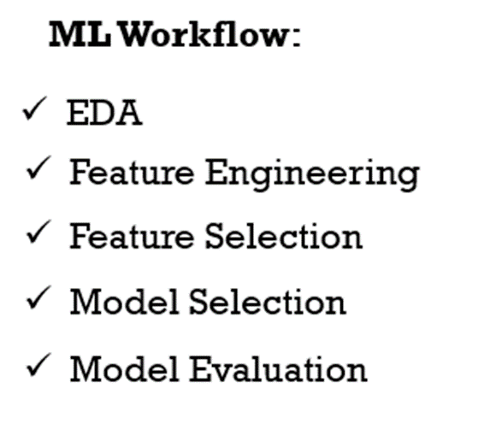


PROJECT-2 GOAL:
The purpose of this group project is to develop a mortgage default model that will determine the probability of default for a mortgage loan with the information at the time of mortgage origination

Slide 3



metric
In our model, we encounter two undesirable scenarios:
There is the situation where it predicts a loan as non-default when it actual
When it predicts a loan as default when it is not.
- Accuracy score
- F1 Score
- ROC (Receiver Operating Characteristic)
- FICO Score
Notes:
In our model, we encounter two undesirable scenarios. First, there's the situation where it predicts a loan as non-default when it actual defaults (false negative), and secondly, when it predicts a loan as default when it isn't (false positive). The second case is particularly costly for the lending institution, so we need to focus on evaluating our metrics with an emphasis on this scenario.
When we analyze the metrics
Accuracy score is typically useful when dealing with equally distributed classes. However, our class distribution is not balanced, and more importantly, false negatives (predicting non-default when it's actual default) are too expensive for us to ignore.
F1 Score, on the other hand, is a valuable metric, especially for imbalanced datasets, as it calculates scores based on a specific threshold. This makes it suitable for our scenario
- ROC (Receiver Operating Characteristic) is also a relevant metric, and it's applicable to both balanced and imbalanced datasets. In our case, it's crucial to note that ROC analysis is threshold-independent, which adds to its utility.
The choice between ROC and F1 Score depends on our specific objectives:
- - If we have a particular operating point in mind and want to evaluate the model's performance at that specific threshold, F1 Score is a good choice.
- - On the other hand, if we need to assess the model's performance across various thresholds and rank the predictions accordingly, ROC is more suitable.
In summary, if we obtain a high F1 score, it indicates that our model is reliable for making predictions. If the ROC curve shows good performance, the model is effective for discrimination tasks. Additionally, we can complement our assessment by considering the borrowers FICO score to determine their eligibility within our financial model

Slide 4
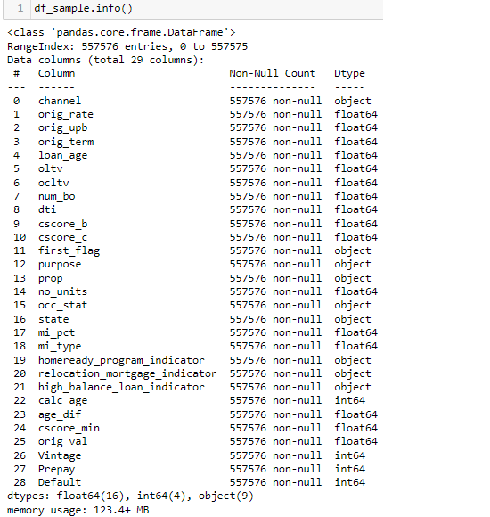
Drop the Columns
Drop the columns that we will not use as model features by following the reasons below for our decision making:
Data columns that contain future information: 'rem_months', 'calc_rem_months'
Data columns that contain information about the target:
'act_period’, 'dlq_status’, 'zero_bal_code’, 'zb_dte’, 'target’.
Data columns that contain date/loan identifier:
'orig_date', 'matr_dt', 'last_period’, 'first_pay’.
Data columns that will create high cardinality:
'msa', ‘zip’.
Notes:
Active period column
Delinquency status column
Zero balance column
Zero balance effective date column
2)Origination date
Maturidy date
Last period
First pay
3) it means that there is a wide variety of unique values in that particular column.Metropolitan statistical area code and
Zip. We need to drop all these columns

Slide 5
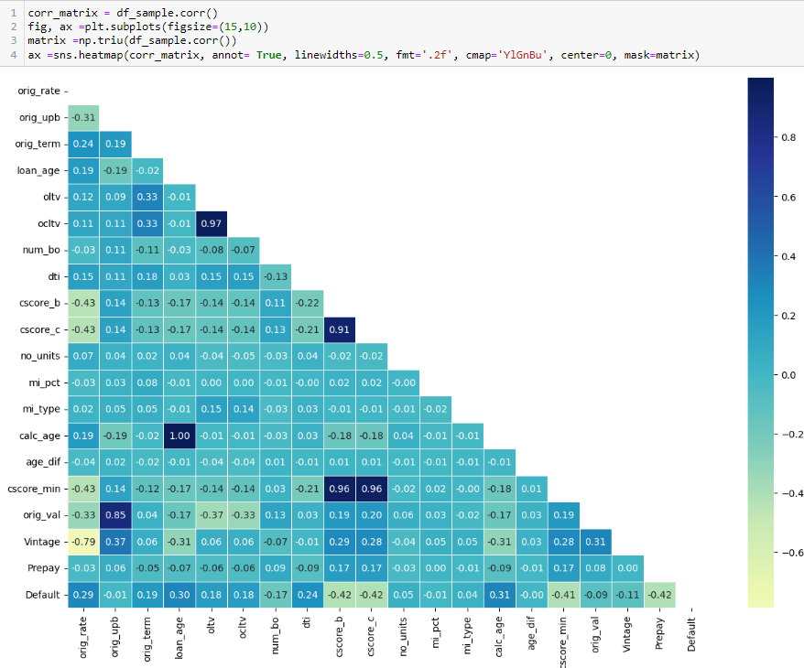
Feature Engineering
Notes:
We can drop cscore_min. It is already derived from cscore_c and cscore_b.
For to get rid of unnecessary time and space wastage.
oltv and ocltv are related in their definition and two of the most important attributes

Slide 6
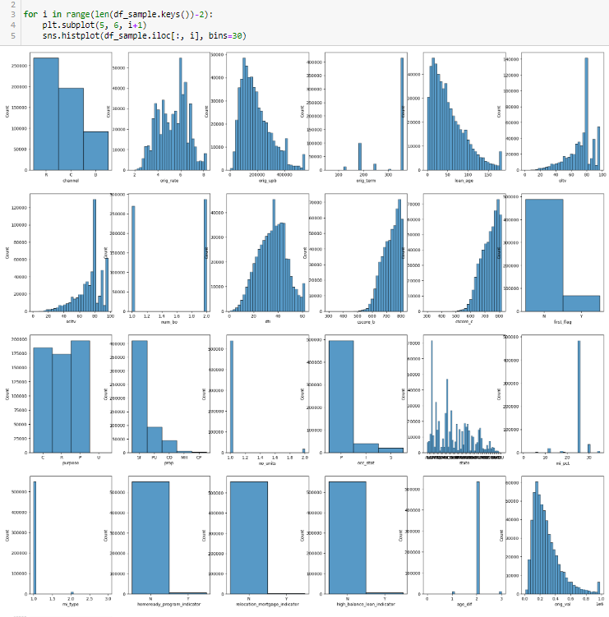
Transformation
Notes:
Some Machine Learning models, like Linear and Logistic regression, assume that the variables follow a normal distribution.
By applying some transformations to these skewed variables, we can map this skewed distribution to a normal distribution so, this can increase the performance of our models.
We can see the distribution only in numerical data

Slide 7
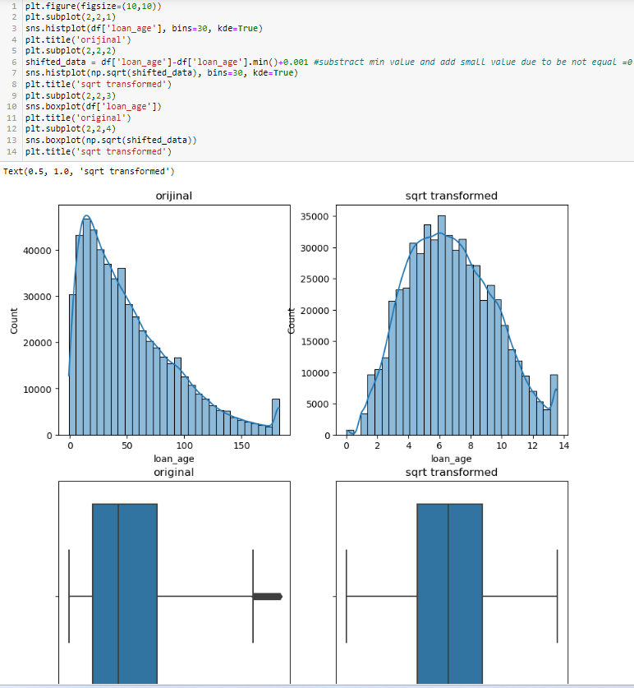
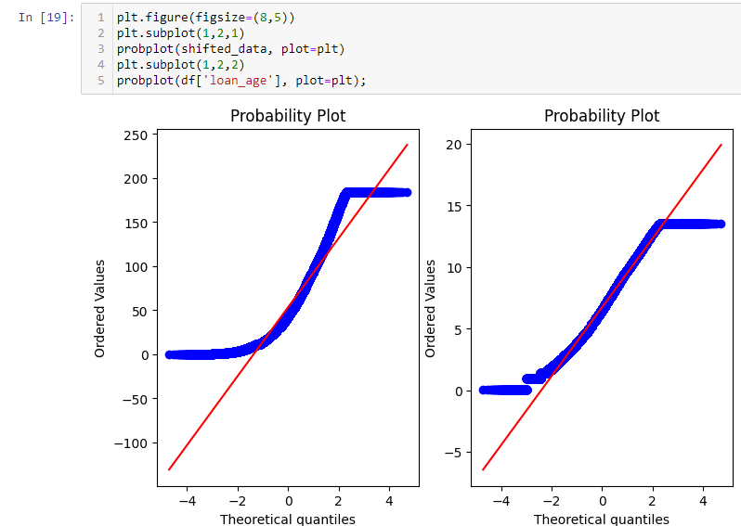

Slide 8
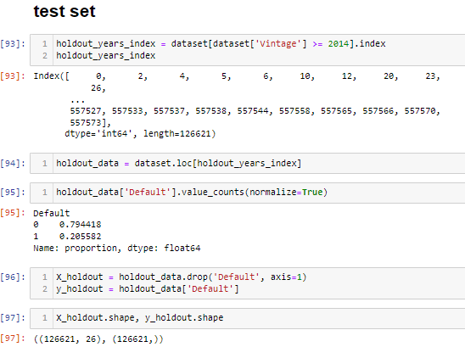
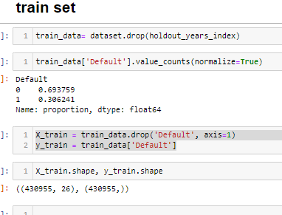
Split the dataset based on vintage
When creating our hold-out dataset we need to think about our business purpose. We would like to use this model to understand the default probability of future originations.
Therefore, it makes sense to evaluate the performance of the model for future acquisitions. With this reasoning, split the dataset based on vintage (origination date)
Notes:
Steybilayz. From our EDA the default rate stabilizes after 3-4 years. So, the vintages chosen should not be later than 2016. From 2009 to 2012 the mortgage market was right after recession, and it was overly conservative so we would like to include those vintages in our model estimation.

Slide 9
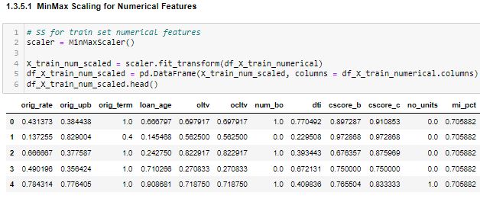
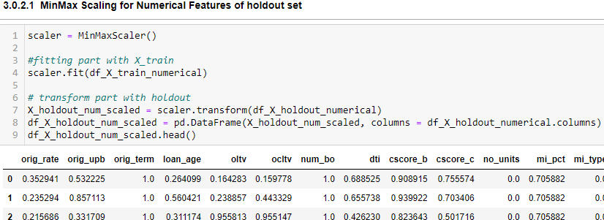
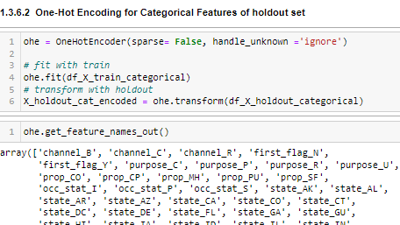
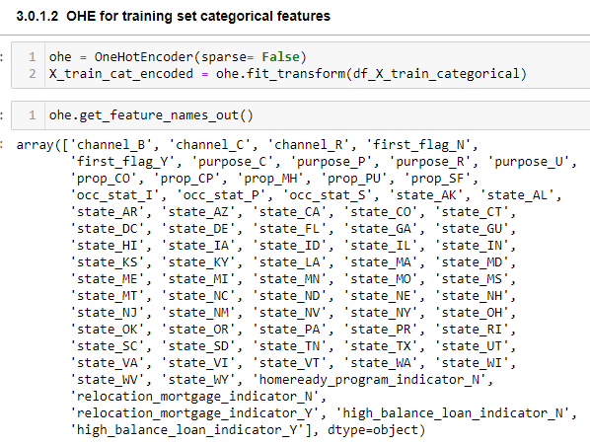
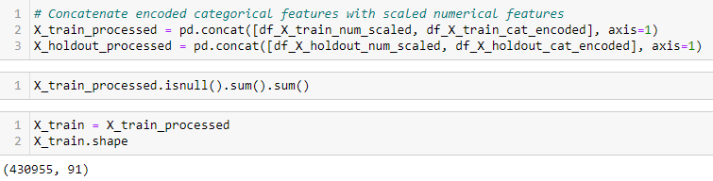
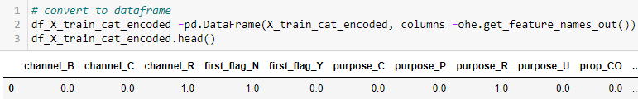
Minmax scaling and ohe
Notes:
Categorical data in its raw form, such as labels or text, cannot be directly used with these algorithms. OHE converts categorical data into a numerical format that can be easily processed by such algorithm

Slide 10
modeling
When selecting a model, we consider these situations:
Performance Explainability Complexity Dataset Size
Training time and cost
White Box Model: White box model is the opposite of a black box model. It is highly transparent and interpretable. You have full visibility into the model's structure and how it makes predictions. Example: linear regression, decision trees, and some types of generalized linear models (e.g., logistic regression).
Gray Box Model: Gray box model lies somewhere in between black box and white box models. It provides a degree of transparency and interpretability, but not as much as a fully white box model.However we can not see the big picture there are a lot of randomness in there.
Black Box Model: Algorithms are not transparent or interpretable by the user. Example: deep neural networks, complex ensemble methods like random forests or gradient boosting, and some types of support vector machines.
Notes:
Now it is time to choose model..
I'd like to talk about box models before mentioning which model we chose
We can choose logistic regression because interpretation is fairly easy, highly transparent and it has less training -test cost
For comparison We will another model use XGBoost which is more complex model with similar performance
XGBoost has performed better in many finance applications that is why we will use these are together

Slide 11
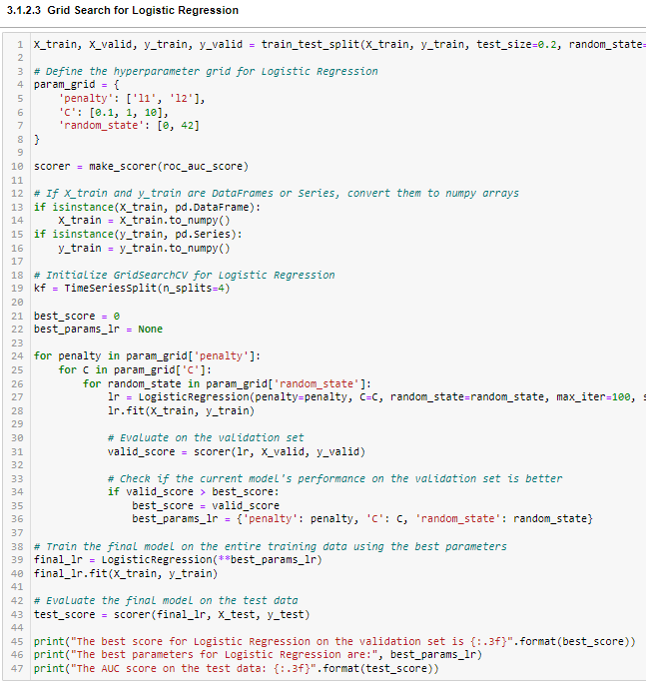
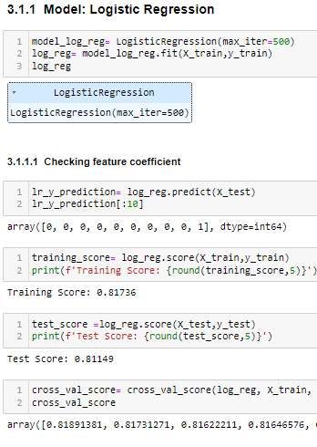
Roc Auc & ACCURACY SCORE (LR)
Notes:
in the class distributions if one class significantly outnumbering the other, accuracy can be misleading. A model that predicts the majority class for all instances can achieve a high accuracy score.that is why it is better to check ROC score. A high ROC AUC indicates that the model is good at distinguishing between the two classes, which is a valuable trait.

Slide 12
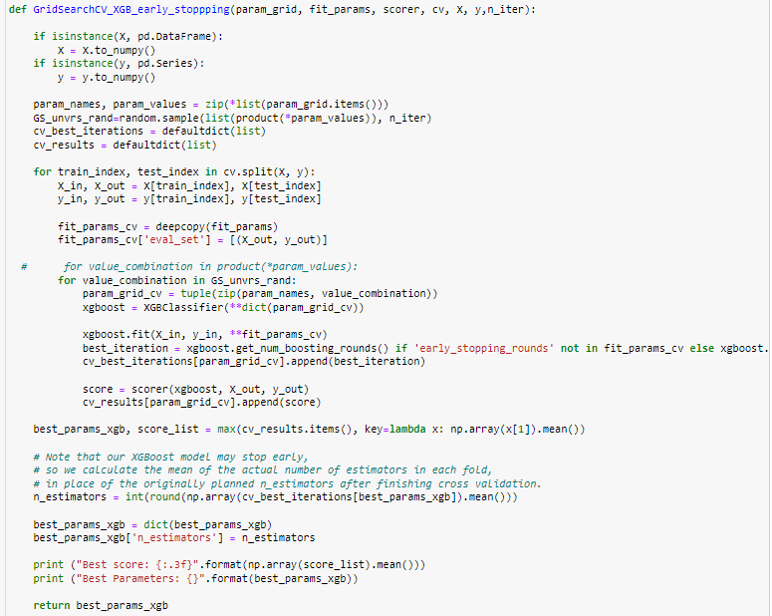
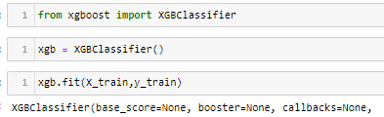
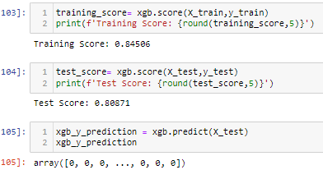
Early stopping & grid search (XGBoost)

Slide 13
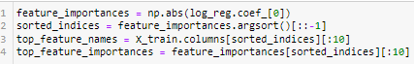
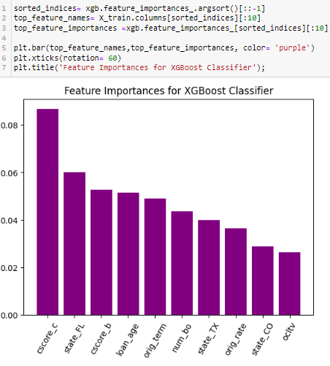
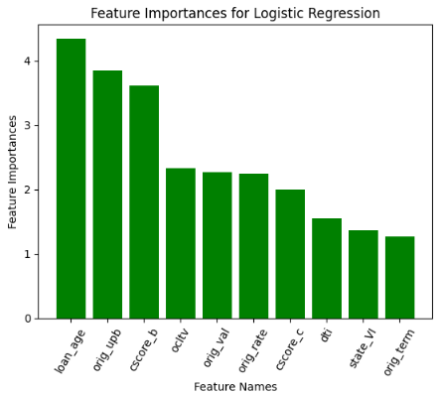
Feature Importance
Logistic Regression
XGBoost Classifier
Notes:
Why the important features looks different here? Log_reg is a linear model it assumes there is linear relationship between features and target variables.xgboost is a more complex model that can capture nonlinear relationship.it consider interaction between feature.thats why they assign different importance to columns
Debt to income

Slide 14
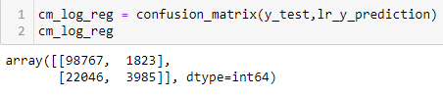
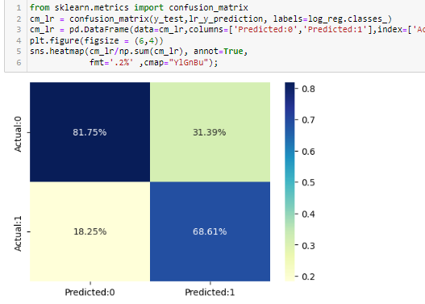
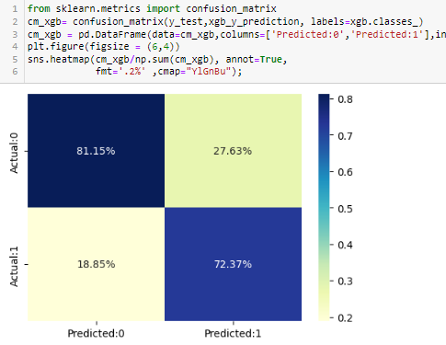
Confusion matrix
Labels = 'Active' , 'Default’
Default = 1 Active = 0
Logistic Regression
XGBoost Classifier
Notes:
True Negatif is 82%,
False positive 31%,
False negative =18%,
True positive= 69%

Slide 15
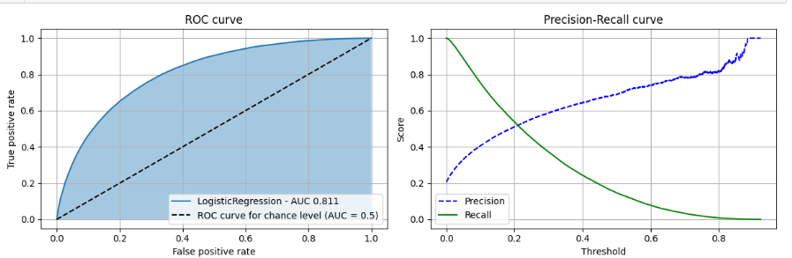
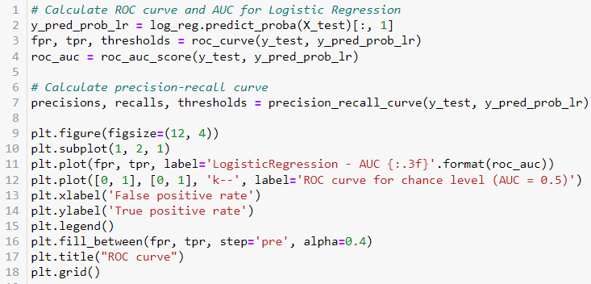
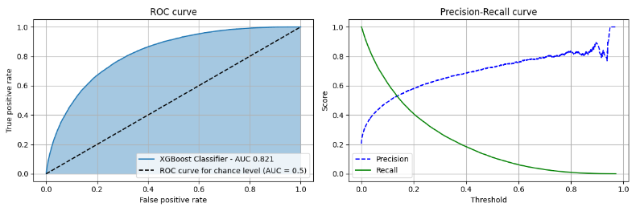
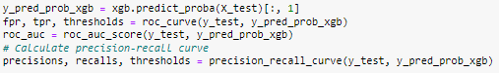
ROC & AUC
Logistic Regression
XGBoost Classifier
0.8 < AUC < 0.9 : Good classifier with moderate discrimination capability.
Notes:
Recivier operating charecteristic and its assosieytid Area Under the curve are tools for assessing and comparing the performance of binary classification models. They help us understand how well our model is distinguishing between positive and negative cases across different classification thresholds, and they are particularly useful when you want to balance the trade-off between true positives and false positives in our model's predictions. A higher ROC AUC indicates better discrimination power.

Slide 16
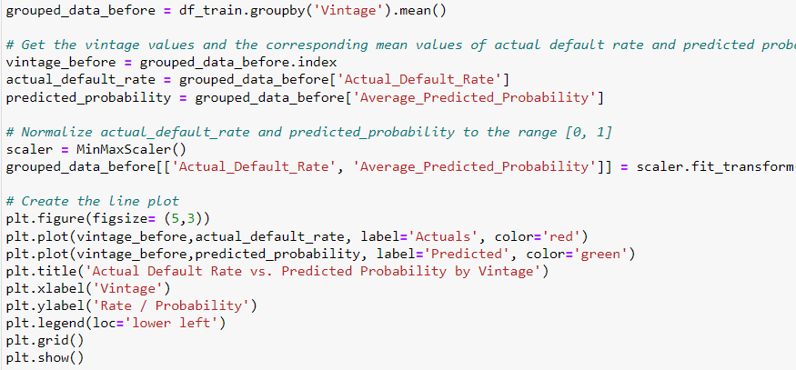
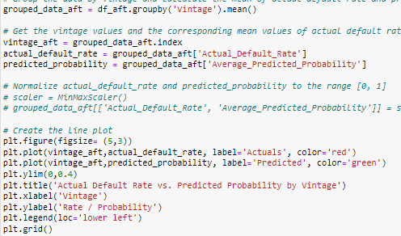
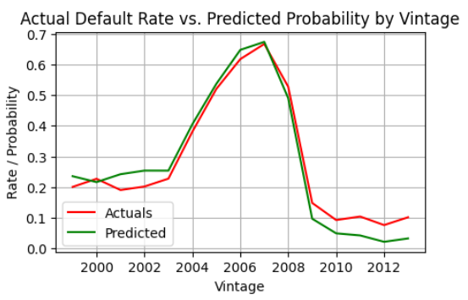
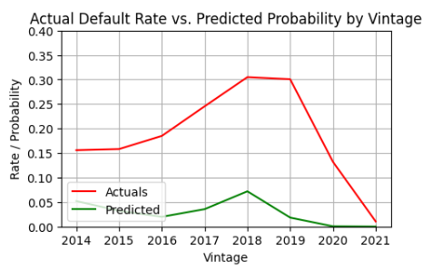
Plot the train set plot the test set

Slide 17

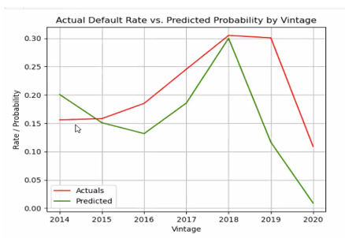
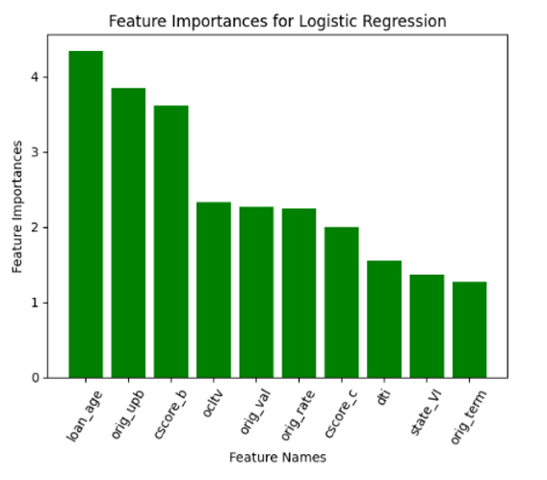
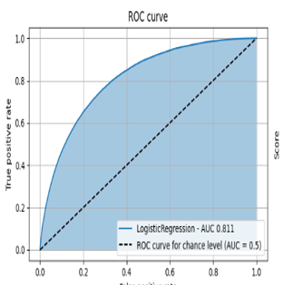
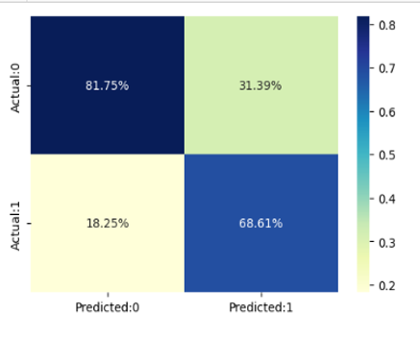
CONCLUSION:
Some changes can be made in the EDA (Exploratory Data Analysis) part
The model can be modified
Enhancing our dataset by adding extra information.
Notes:
Based on our understanding of all evaluation teqhniques it appears that our model is not bad but also not excellent.Still There is room for improvement.
To improve our model more; We can some changes at EDA part but we already tried all kind transformation scaling encoding and we picked best ones.
We can change models but we already tried other models too and on avarege we obtained the same result.
Or maybe we can add some extra information to our dataset. Lastly we consider enhancing our dataset by adding extra information. We focused on this and decided to add House price and unemployment dataset to our loan dataset. Project-2 presentation is done. Now Seyda is going to make a presentation about project -3 which has extra new datasets. I hope you enjoyed, Thank you for listening.

